Slide 1
University Of Basrah Collage Of Nursing
Lecture 1
The Microscope
by
Assistant Lecture
Zahraa Mahmoud Hussain

Slide 2
The Microscope It is a scientific equipment that magnifies very small objects that is not visible to the naked eye to an extent where it can be seen clearly.
Microscope Micro= Small Scope= To look

Slide 3
Common Type Of Microscope
Simple Microscope: has one optical lens.
2. Compound Microscope: it has two lenses objectives and ocular, it is used visible light as source of illumination.
3. Dark-field microscope.
4. Electron microscope: it used flow of electron insteated of light.
5. Fluorescence Microscope: use ultraviolet light.

Slide 4
Uses Of Microscope
The microscope is one of the most commonly used instruments in the medical and life sciences colleges, and in clinical laboratories.
» Physiology: in the study of morphology of blood cells and in counting their numbers.
» Histology: histopathology and tissue analysis.
» Microbiology: to study various type of bacteria, parasite and fungi.

Slide 5
Part Of Compound Microscope
1. Arm: carry the microscope and supports lenses.
2. Base.
3. Course Focusing Knob (Coarse adjustment screw).
4. Fine Focusing Knob (Fine adjustment screw).
5. Illuminator.
6. Numerical Aperture or Objective Lens.
( the closest to the specimen)
7. Ocular Lens.
( the closest to the eye)
8. Stage.

Slide 6
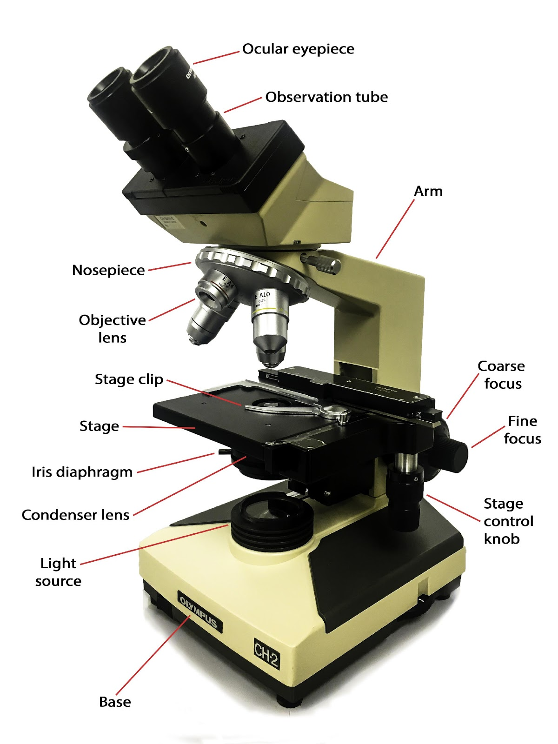
This Photo by Unknown Author is licensed under CC BY-SA-NC

Slide 7
Thank you for listening

